Slide 1
Advance Java

Slide 2
Inner Classes

Slide 3
Why we use inner classes?
Encapsulation and Organization
Access to Enclosing Class Members
Callback and Event Handling
Enhanced Code Reusability
Improved Readability and Scope Control
Data Structures and Algorithms

Slide 4
Inner Class
Inner classes, also known as nested classes, are classes defined within another class in Java. They provide a way to logically group classes that are closely related and increase encapsulation and code organization.
Inner classes have access to the members (variables and methods) of the enclosing class, including private members.
Java supports four types of inner classes:
Member Inner Class
Static Nested Class
Local Inner Class
Anonymous Inner Class

Slide 5
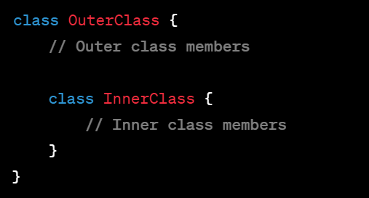
Member Inner Class :
A member inner class is a class defined within the scope of an outer class. It is associated with an instance of the outer class and has access to all members (including private members) of the enclosing class. The member inner class can be instantiated only with an instance of the outer class
Syntax :

Slide 6
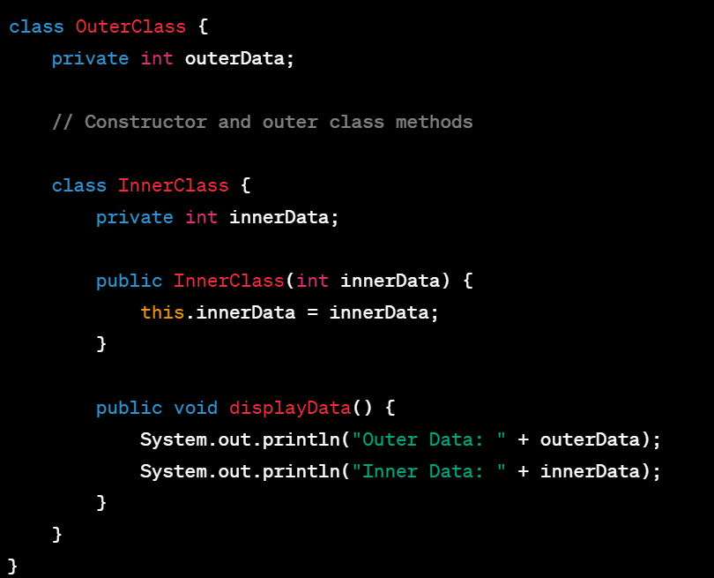
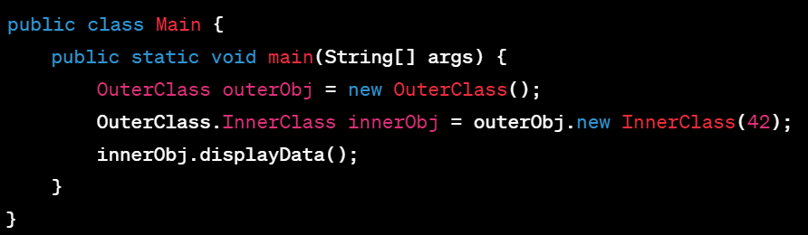
Example :

Slide 7
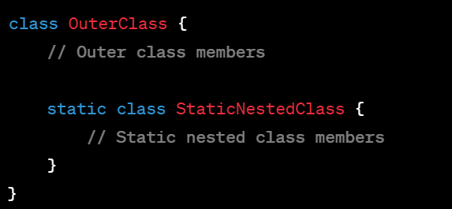
Static Nested Class
A static nested class, also known as a static inner class, is a class defined inside another class as a static member.
It is not associated with an instance of the outer class and can be accessed using the outer class name. A static nested class cannot directly access non-static members of the outer class.
Syntax :

Slide 8
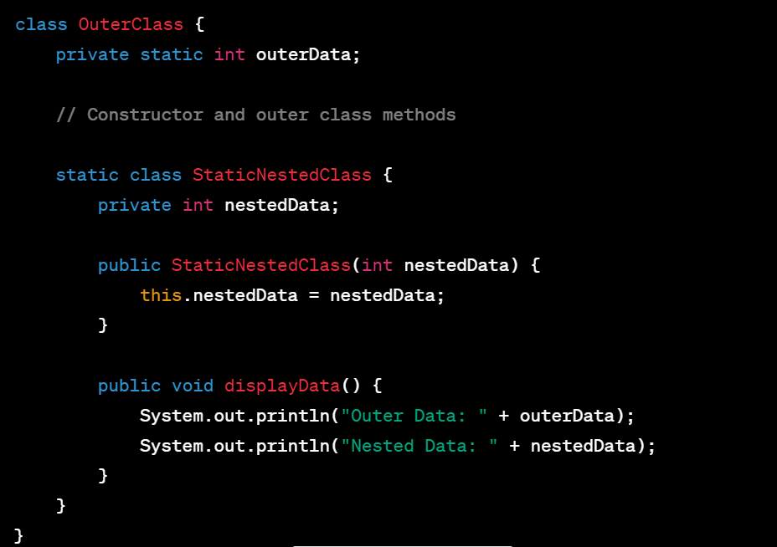
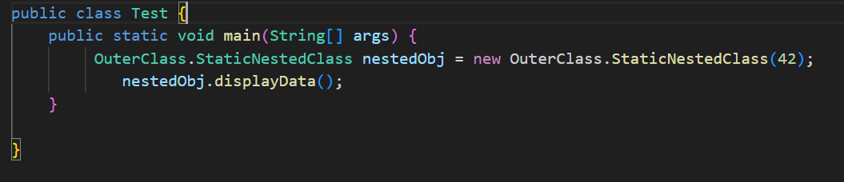
Example

Slide 9
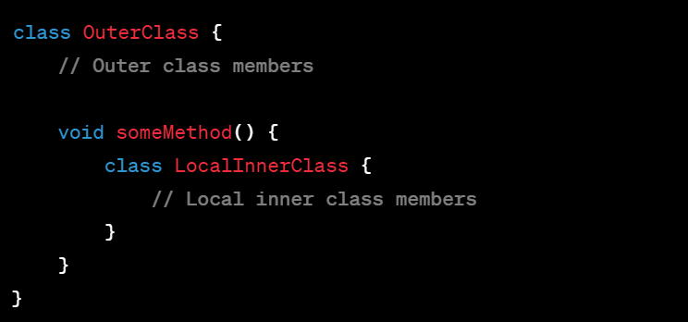
Local Inner Class
A local inner class is a class defined within a method or a block of code. It is only accessible within that method or block.
A local inner class has access to the members of the enclosing class and the local variables of the method or block. However, the local variables must be final.
Syntax :

Slide 10
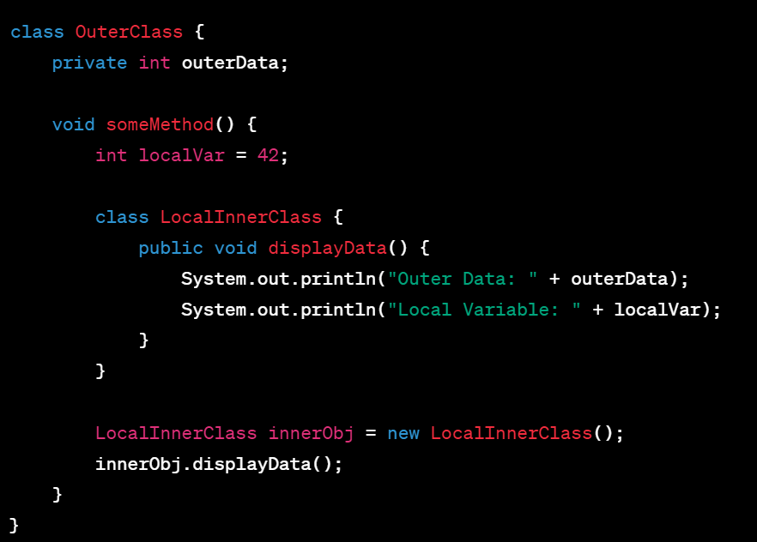
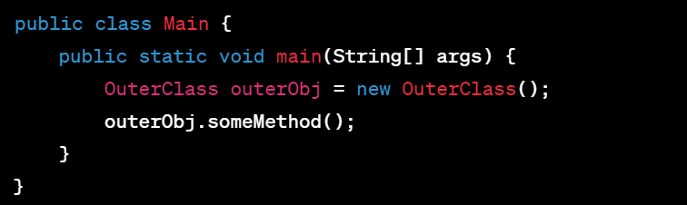
Example:

Slide 11
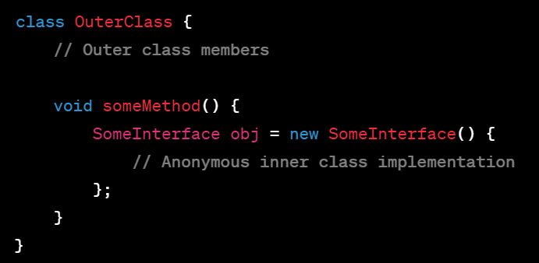
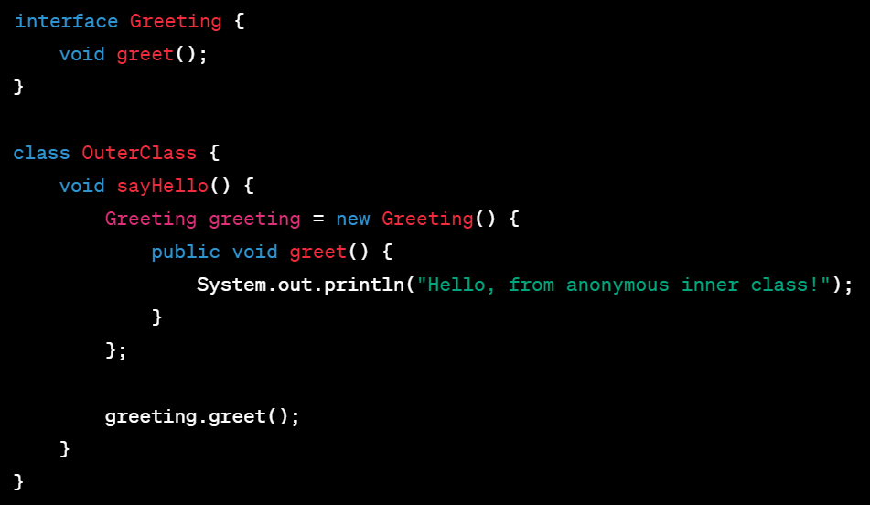
Anonymous Inner Class
An anonymous inner class is a local inner class without a name. It is typically used when you need to provide an implementation of an interface or extend a class for a single-use scenario. Anonymous inner classes are created and instantiated at the same time.
Syntax and example:

Slide 12
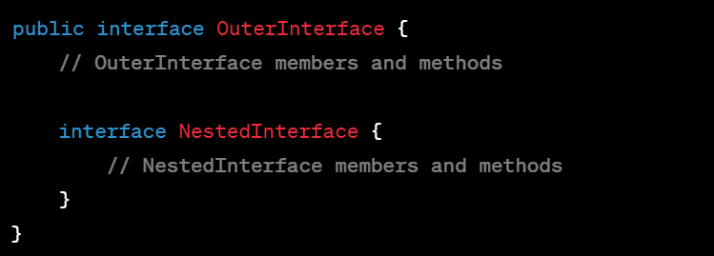
Nested Interface
An interface within another interface or class is known as a nested interface. Similar to other nested classes, a nested interface has access to the members (including other interfaces) of the enclosing interface or class.
Syntax :

Slide 13
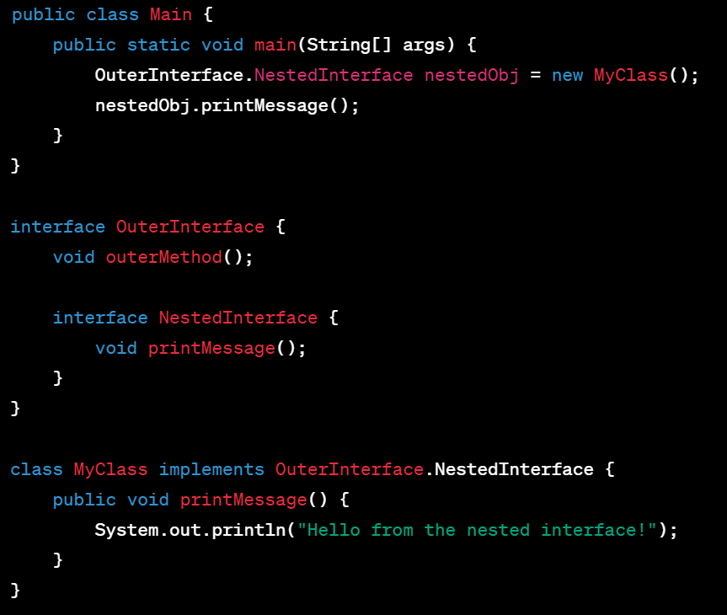
Example

Slide 14
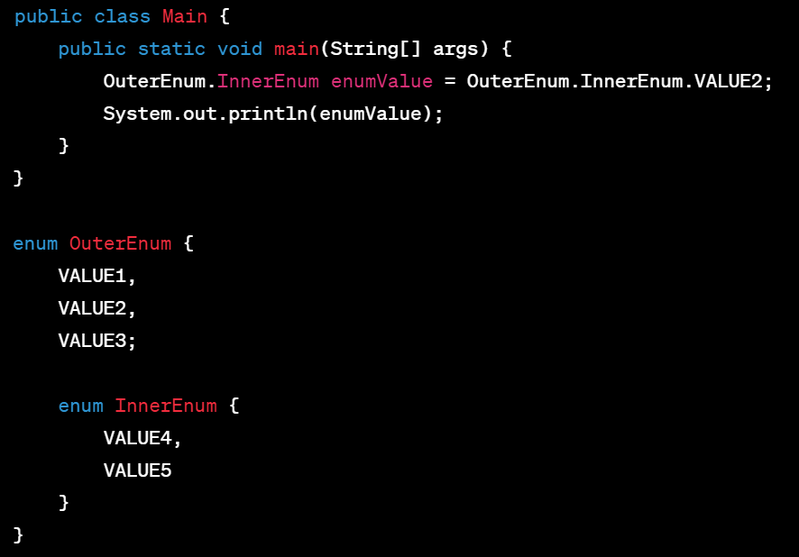
Nested Enums
Nested enums in Java refer to defining an enum type within another class or enum. This allows you to encapsulate related constants within a specific scope.

Slide 15
Java API Techniques

Slide 16
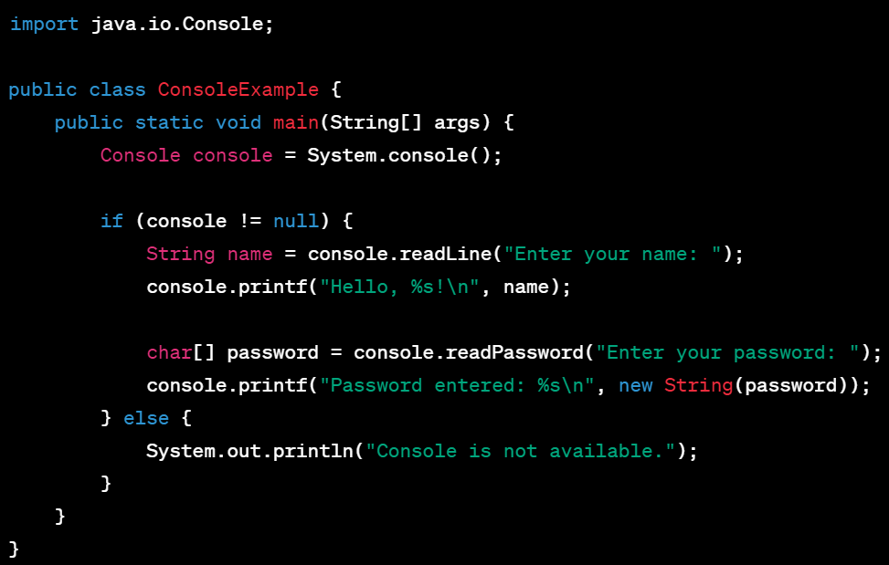
Java Console Class
java.io.console class provides a simple way to interact with the console or command line for input and output operations. It allows you to read input from the user and write output to the console
Example –

Slide 17
String Builder class
The StringBuilder class provides a flexible and efficient way to manipulate strings in Java. It is widely used in scenarios where string concatenation or modification is required. It helps in efficient and mutable string manipulation
Usage –
Creating StringBuilder Objects
Appending and Inserting (append method)
Modifying and Deleting (setCharAt, replace, delete)
Converting to String (toString)
Chaining Operations (append)
Performance Considerations

Slide 18
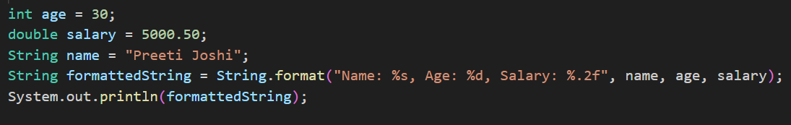
Java Formatting Techniques
In Java, there are several techniques available for formatting data, including numbers, dates, and strings. These techniques help you control the appearance and structure of your data output.
Few Examples are –
String Formatting – String.format() method allows you to format strings using placeholders and format specifiers. You can specify the format of variables, such as integers, floating-point numbers, and strings, by using % placeholders and format specifiers like %s, %d, %f etc

Slide 19
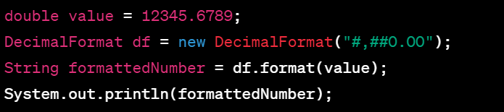
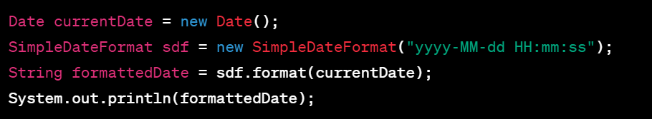
Number Formatting – The DecimalFormat class allows you to format numerical values, such as integers and floating-point numbers, with customizable patterns. You can specify the number of decimal places, thousands separators, and other formatting options.
Date and Time Formatting : The SimpleDateFormat class provides formatting and parsing of dates and times based on patterns. You can define your desired date and time formats using pattern letters, such as yyyy for year, MM for month and dd for the day.

Slide 20
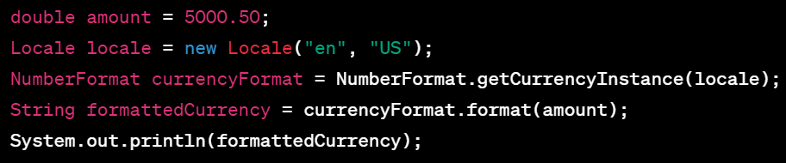
Formatting Currency – The NumberFormat class provides formatting for currencies. It allows you to display currency values according to the locale-specific format, including currency symbol, decimal separators, and grouping separators
Other examples include – CHINA, FRANCE etc

Slide 21
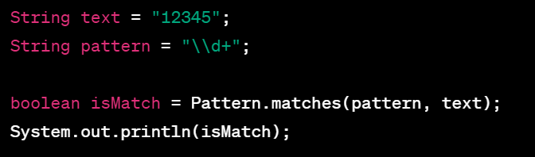
Regular Expressions
The pattern \d+ matches one or more digits.
The pattern \d+ matches one or more digits.
Regular expressions in Java are patterns that can be used for matching and manipulating strings. The Java language provides support for regular expressions through the java.util.regex package.
The basic operations that the regex allows are –
Matching a Pattern: (\d+ matches one or more digits)

Slide 22
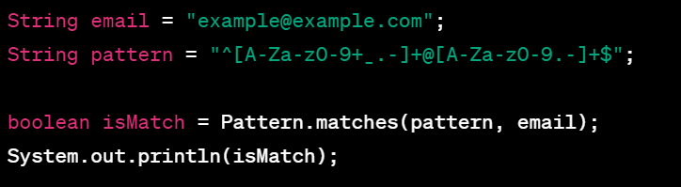
The pattern ^[A-Za-z0-9+_.-]+@[A-Za-z0-9.-]+$ validates the format of an email.

Slide 23
Localisation and Resource Bundles

Slide 24


Locales
In Java, locales are used to specify regional and cultural preferences for formatting and displaying data such as numbers, dates, times, and currencies. The java.util.Locale class provides support for working with locales.
Getting default Locale – This fetches the location of the JVM. Ex – en-IN, en-US, en-CA (India, US, Canada etc)
Creating a Specific Locale –
Here we create s specific locale for English using language code “EN” and “US” is the country code

Slide 25
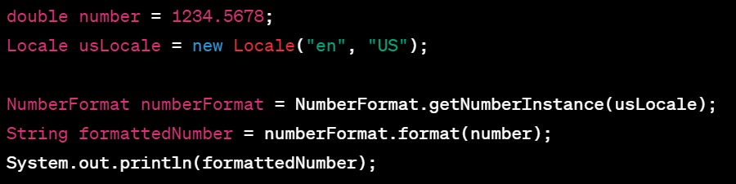
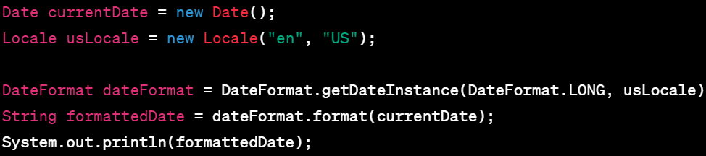
Formatting Numbers with a Locale:
Output – 1,234.5678
Formatting date with Locale

Slide 26
Resource Bundles
Resource bundles in Java are used for internationalization (i18n) and localization (l10n) purposes. They allow you to store locale-specific resources such as strings, messages, labels, and other configurations.
Resource bundles provide a flexible mechanism for managing localized resources in Java applications, allowing you to easily support multiple languages and locales without modifying your code
The java.util.ResourceBundle class is used to access and manage these resources.
Creating Resource bundles : To create a resource bundle, you typically have multiple properties files, each corresponding to a specific locale. The properties files contain key-value pairs for the localized resources. For example, you may have messages_en.properties for English, messages_us.properties for French and so on. These can be managed under resources directory of project.

Slide 27
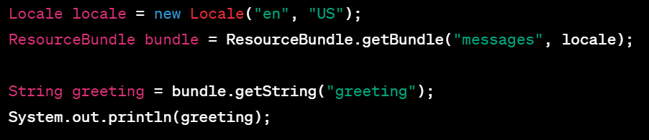
Accessing Resource Bundles: To access the resources from a resource bundle, you need to load the appropriate bundle based on the desired locale. The Resource.getBundle method is used to obtain the bundle instance. You can specify the base name of the resource bundle, the desired locale, and the class loader to use.
Default Locale and Fallback: If a specific locale resource bundle is not found, Java will use the default (fallback) locale resource bundle. If the default locale is not available, it will fallback to the default properties file without a locale suffix.

Slide 28
Logging

Slide 29
Overview
Java Logging is a built-in logging framework provided by the Java platform for capturing and managing log messages in Java applications. It offers a flexible and configurable logging system that allows developers to record application events and troubleshoot issues
Loggers: Loggers are the entry points to the Java Logging framework. They are typically defined as static variables within classes and used to log messages. Loggers are named hierarchically, following a dot-separated naming convention, allowing developers to organize and categorize log messages effectively
Logging can be configured using a configuration file logging.properties. The configuration file allows developers to specify properties such as log levels, handlers, formatters, and logging destinations

Slide 30
Log levels
FINEST: Indicates the most detailed (and usually the most verbose) level of logging. It is typically used for tracing and debugging purposes. This level produces the most output.
FINER: A slightly less detailed level than FINEST, used for more fine-grained debugging information.
FINE: Indicates informative debug messages that are less detailed than FINER level logs.
CONFIG: Used for providing configuration-related information.
INFO: Indicates informational messages about the progress or state of the application. It is typically used for important application events.
WARNING: Indicates potential issues that might cause problems but are not critical.
SEVERE: The highest level of severity, indicating critical errors or exceptions that may cause the application to terminate or fail.
DEBUG: When the logging is set to DEBUG level, it allows developers to capture detailed information about the execution flow of the application

Slide 31
Best Practices
Use the appropriate log level
Include relevant information
Use parameterized logging
Log exceptions properly
Enable logging only when necessary
Customize the log output format, destinations, and log handlers based on your application's needs. Use configuration files

Slide 32
Log4j
Log4j is a powerful logging framework with extensive features. It enables developers to effectively capture and manage log messages, control logging behavior, and integrate with other logging APIs. Its rich ecosystem and active community make it a popular choice for logging in Java applications
Features of Log4j
Logging Levels and Loggers: Log4j supports different logging levels, including TRACE, DEBUG, INFO, WARN, ERROR & FATAL
Appenders: Appenders are responsible for delivering log messages to various destinations such as the console, files, databases, or remote servers. Log4j provides a wide range of built-in appenders, including ConsoleAppender, FileAppender, JDBCAppender etc. Log4j also allows developer to create custom Appenders as per the application requirement.
Layouts: Layouts define the format of log messages. They determine how log messages are transformed into a textual representation. Log4j supports different layouts, such as PatternLayout, HTMLLayout, XMLLayout, JSONTemplateLayout and many more. Developers can choose an appropriate layout or create custom layouts to format log messages according to their preferences
Easy Configuration : Log4j can be configured through a configuration file, typically named log4j2.xml or log4j2.properties. The configuration file allows developers to define loggers, appenders, layouts, logging levels, and other settings. It provides fine-grained control over the logging behavior of the application. Alternatively, Log4j can be configured programmatically using the Log4j API.

Slide 33
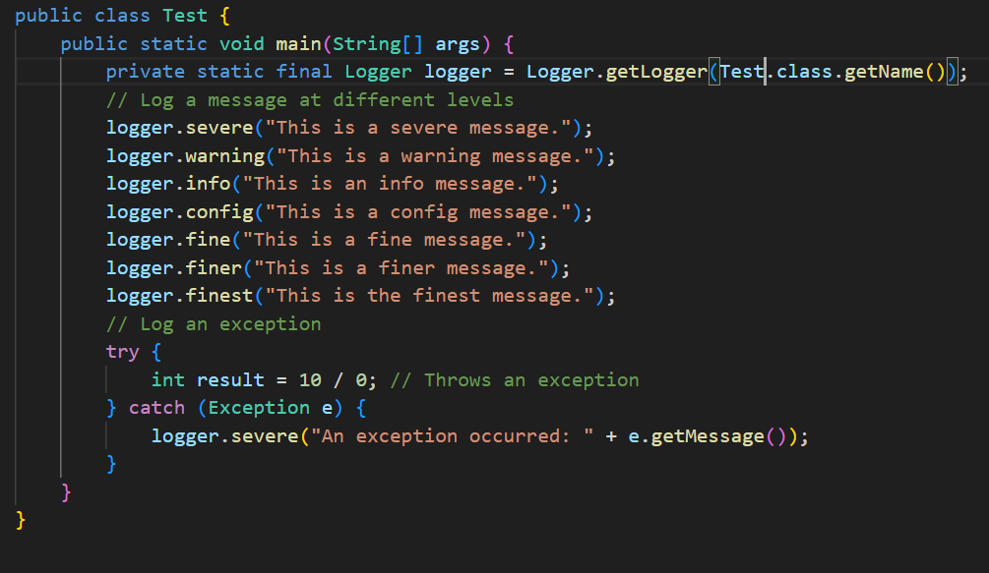
Asynchronous Logging: Log4j offers asynchronous logging capabilities to improve performance and reduce overhead. Asynchronous logging separates the log message generation from the actual writing to the log destination, allowing the application to continue its execution without waiting for the log messages to be written.
LOGGER example

Slide 34
Garbage Collection

Slide 35
What is garbage collector?
In Java, object lifecycle and memory management are handled by the garbage collector. The garbage collector is responsible for reclaiming memory occupied by objects that are no longer referenced and freeing up resources.
Object Life cycle
Creation: Objects are created using the new keyword or through other means like object deserialization or reflection. When an object is created, memory is allocated for it on the heap.
Reachability: Objects become eligible for garbage collection when they are no longer reachable or referenced by any live threads or active variables in the program. Java uses a technique called reachability analysis to determine which objects are reachable.
Marking: The garbage collector performs a marking phase where it traverses through the graph of reachable objects starting from the root objects (such as static variables, method parameters, and active threads). Any objects that are not marked during this traversal are considered unreachable.
Sweep and Deallocate: After marking, the garbage collector performs a sweep phase where it r reclaims memory from the unreachable objects. It deallocates the memory occupied by these objects, making it available for future object allocations

Slide 36
Generational Collectors
Generational collectors are a type of garbage collector that divide the heap into different generations based on the age of objects.
The heap is divided into three main generations:
Young Generation: This is where new objects are allocated and aged. The young generation is further divided into two areas: Eden space and survivor spaces (usually called S0 and S1). When objects are first created, they are allocated in the Eden space. As the Eden space fills up, a minor garbage collection (also known as a young collection) is triggered. The objects surviving the garbage collection of Eden space are moved to S0. The S1 is the pool containing objects that have existed for sometime in S0. Objects that survive several minor collections are promoted to the old generation.
Old Generation (Tenured Generation): This generation contains objects that have survived multiple minor collections and are considered long-lived. Objects in the old generation are typically larger in size and less likely to become garbage. When the old generation fills up, a major garbage collection (also known as a full collection) is triggered. A major collection involves collecting the entire heap, including both the young and old generations. It can be a more time-consuming process compared to minor collections.

Slide 37
Permanent Generation: In older versions of Java, the Permanent Generation was a separate region of the heap used to store metadata about classes, method bytecode, and other runtime data. It held information related to the Java Virtual Machine itself rather than application data. However, starting from Java 8, the Permanent Generation was removed and replaced by the Metaspace, which is a native memory area outside of the heap.
Metaspace (Java 8 and later): In Java 8 and later versions, the Metaspace replaced the Permanent Generation. The Metaspace is a native memory area outside of the heap used to store class metadata, method bytecode, and other reflective information. It dynamically grows and shrinks based on the application's needs.

Slide 38
Benefits of Generational Garbage Collection
Reduced garbage collection overhead: By focusing on the young generation, garbage collection can be performed more frequently and efficiently, as it only needs to examine a smaller portion of the heap.
Improved application throughput: By quickly reclaiming short-lived objects, generational collectors can minimize the frequency and duration of stop-the-world garbage collection pauses, resulting in better application performance
Enhanced memory locality: Objects that survive minor collections are promoted to the old generation, which can improve memory locality and reduce the impact of memory fragmentation.

